Slide 1

Golden Thread: Change
Expedition: ‘Is change always go?’
Humanities
Pupils will be exploring:
How have the lives of children changed through History? How has a typical day in school changed?
How has the village of St Nicholas changed and how has St Nicholas School itself changed?
Can changes in materials be reversed? Investigating the changes in water as it heats up and cools down. How does food change when we cook it? And can these changes be reversed?
How has our planet changed? What have been the effects of climate change? What can we do to prevent this change from continuing?
Expressive Arts
Pupils will:
Study and complete art work in the style of William Morris.
Develop performing skills including acting and staging.
Develop singing skills.
Health & Wellbeing
Pupils will:
Develop their fitness levels working on different areas of the body.
Develop their travelling, rolling, balance, jumping and sequencing skills in gymnastics.
Continue to develop a Growth Mindset
Science and Technology
Pupils will:
Investigate reversible and irreversible change.
Design and make a ‘toasty’.
Develop coding skills.
Present work using a range of digital media.
Languages, Literacy and Communication
Pupils will:
Fiction: Use the Introduction to the Iron Man as a basis for their fictional writing and write and perform letters to Santa
Non-Fiction: Write recounts and Instructions.
Oracy: Presentation to the class.
Maths and Numeracy
Pupils will:
Recognise place value in 2 and 3 digit numbers.
Order and compare numbers up to 1000.
Understand 10 times bigger & 10 times smaller.
Develop strategies for addition & subtraction of bigger numbers.
Explore links between multiplication & division facts.
Interpret data in a range of forms.
Explore units of measure.

Slide 2
Dosbarth Sycamore Important Information
Welcome to Dosbarth Sycamore! What a busy start we have already made to the new academic year, as we have settled into our new class and got to know one another.
Here is some useful information about Dosbarth Sycamore.
Reading - Home reading books will be sent home soon. Pupils will be given an allotted day on which to bring their book bags back into school in order for us to respond to any comments made in their reading records and to change their books if they have been read. Please can all children bring in their book bags on these allotted days from next week onwards. A note will be placed into the book bags with the details of your child’s allocated day. We would really appreciate it, if you could record in your child’s reading record each time they read, in order for us to monitor their progress and change their books on a regular basis. You could also record every time they read any other reading materials that you may have at home. Pupils will also have a book in school which will be read to staff on a regular basis and they will take part in either daily phonics or weekly Guided Reading sessions.
Spellings – Weekly spellings will posted on Google Classroom on a Wednesday and the words for this half term for each group are below. These can be copied in order to be practised at home or printed out. Whilst pupils will have regular opportunities to practice these is school, additional practice at home is strongly encouraged. Spellings will then be tested in the week. (The day on which they are tested may vary from week to week.)
Maths Homework – Each half term pupils will be given multiple multiplication grids on which they can practice their recall of the multiplication tables in readiness for their weekly tests held on a Friday.
Oracy Homework – Please see below for details.
Jackets - Please bring a rain jacket every day, whatever the weather. We will continue to work on outdoor activities regardless of the weather!
PE – Two sessions of PE will usually be held between Tuesday and Thursday, but this can be affected by the weather and therefore pupils should wear sensible trainers to school (not high tops) every day.
Many thanks for your continued support, diolch yn fawr iawn,
Miss Morris and Miss McIntyre

Slide 3
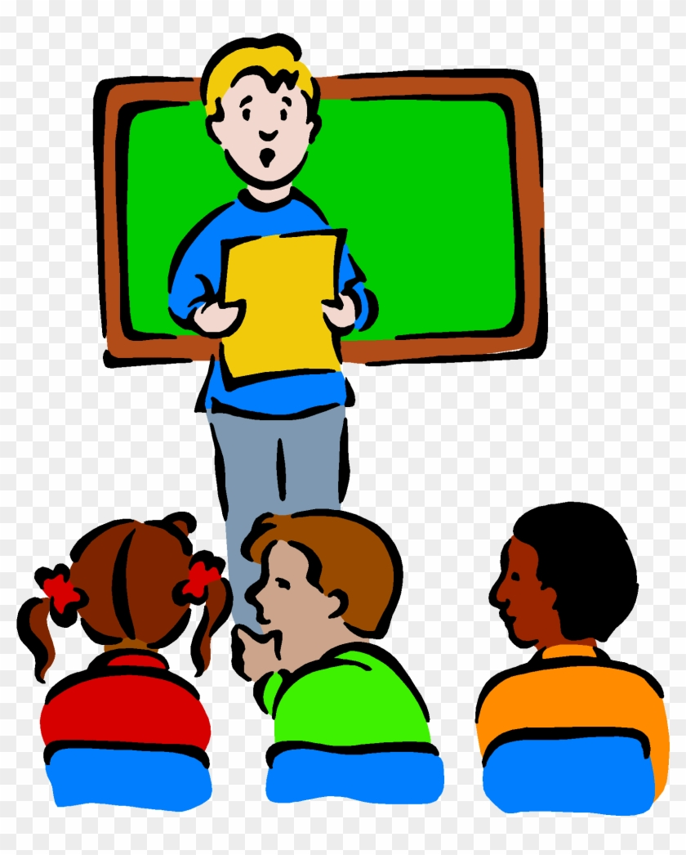
This term we are asking all pupils to write and rehearse a presentation to be made to the class as part of their ongoing Literacy assessments. These will take place on the second week back after half term, week beginning the 10th November. Presentations will last 5 minutes.
As our topic this term is based on the theme of change, we are asking all pupils to create a presentation about themselves, how they have already changed, what they are like now and what they want to be when they are adults. It could be called ‘Me: Then, Now, Next’
Step 3
Decide how you want to make your presentation.
It can take the form of a collage of pictures of yourself, a written speech or a Powerpoint created on your Hwb account, or any other way in which you would like to present to the class about you, how you have changed and what you want to do when you become an adult.
Step 1
Decide on a logical order for the presentation.
What will you talk about and in what order?
Decide what additional information you could add such as people that you admire or that inspire you as you work towards your goals in adult life.
Step 2
Complete any research needed.
Talk to your family about what you were like as a baby and when you started to walk, talk etc.
Step 4
Practice your presentation, looking at the skills on the next page as these are what you’ll be assessed against.

Slide 4
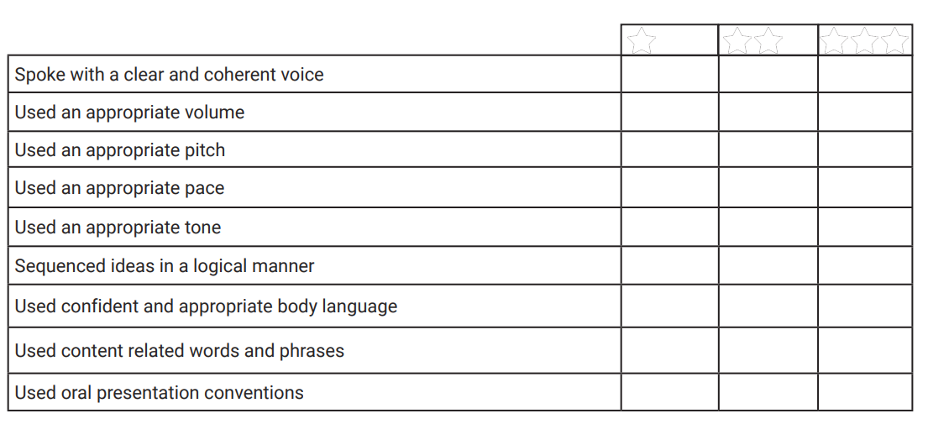

Slide 5
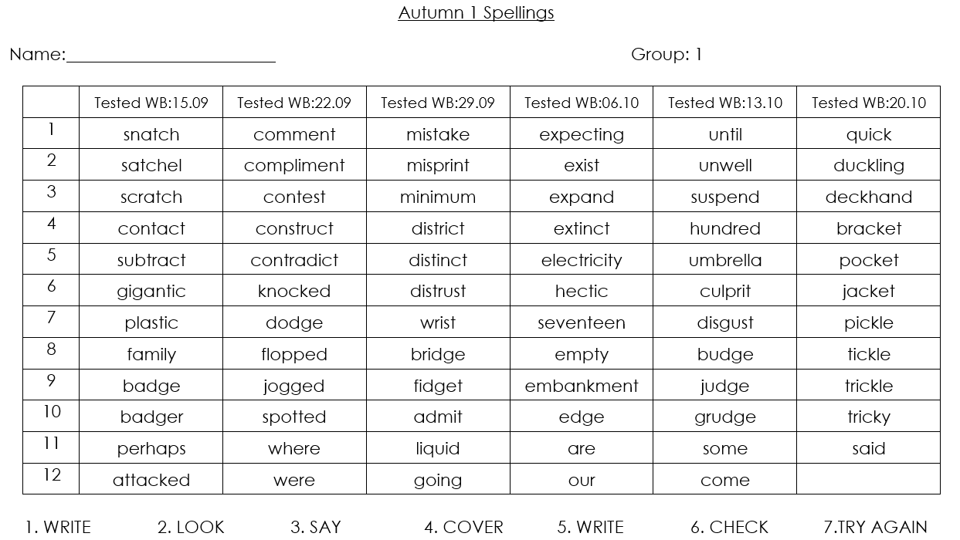

Slide 6
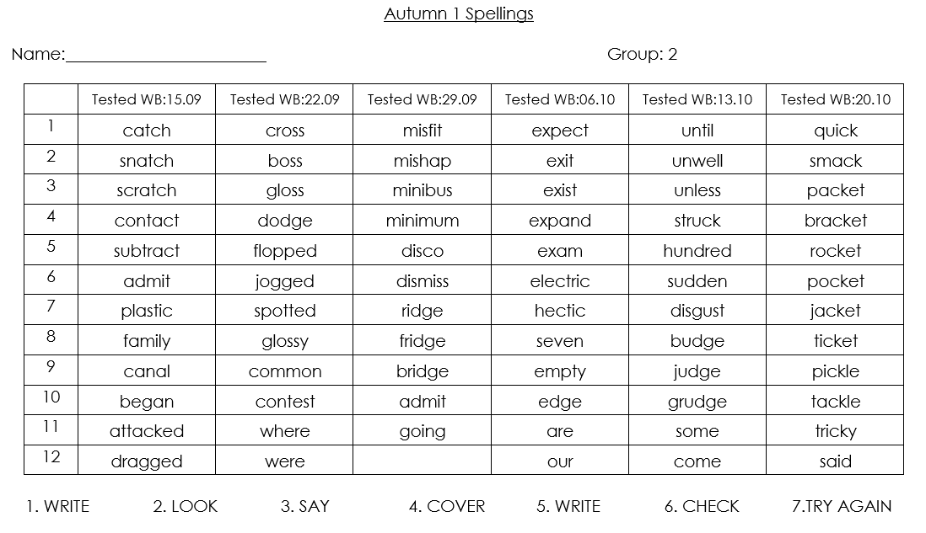

Slide 7
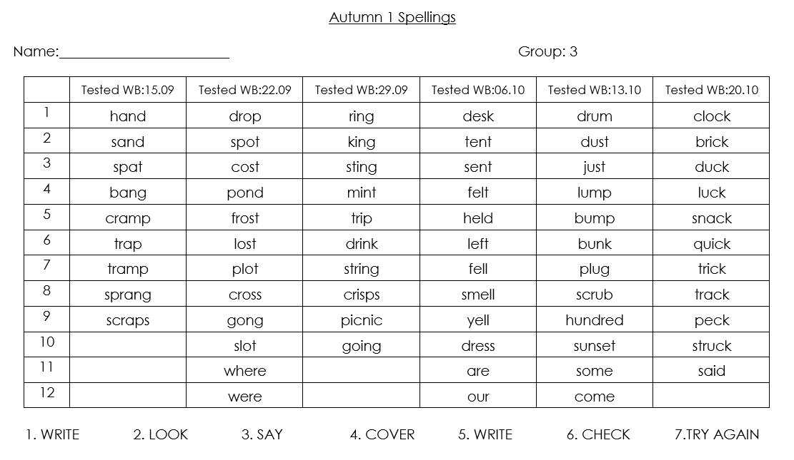

Slide 8


